Slide 1
Multivariable regression & Interactions

Slide 2
Introduction
The principles of Simple Regression Analysis can be extended to two or more explanatory variables.
With more explanatory variables we get an equation
Y = β₀ +β₁X₁ + β₂X₂ + ... + β_{i}X_{i} + ε
Where : Y – response/outcome
X_{i} – predictor/explanatory variables
β_{i} – parameters
ε – Error term

Slide 3
Example
Factors influencing SBP:
- salt/sugar intake?
- age?
- gender?

Slide 4
Assumptions
The errors are normally distributed
The mean of the errors is zero
Errors have a constant variance
The model errors are independent

Slide 5
Model Building Process
#### Generated data:
library(mvtnorm)
set.seed(100)
#SBP-- Normal (124,10) &&& Age-- Normal (23,5)
data<- rmvnorm(n=10000,mean=c(23,124),sigma=matrix(c(5,0.7*sqrt(50),0.7*sqrt(50),10),2,2))
colnames(data)<-c("Age","SBP")
data<-data.frame(data)
###Salt_sugar-- intake : 1-8 spoons
data$salt_sugar<-NULL
data$salt_sugar[data$SBP>mean(adata$SBP)]<-sample(5:8)
data$salt_sugar[is.na(data$salt_sugar)]<-sample(1:4)
###Gender::
data$gender<-sample(1:2)
data$gender<-factor(data$gender,levels=1:2,labels=c("Male","Female"))

Slide 6
Exploring the response
Check response distribution:
- Graphical techniques (histogram, density plot).
head(data)
Age SBP salt_sugar gender
23.16372 127.0646 6 Male
23.14923 123.7815 2 Female
22.56527 123.0816 4 Male
24.83298 125.0407 5 Female
22.11465 120.7102 1 Male
24.81333 127.8849 8 Female

Slide 7
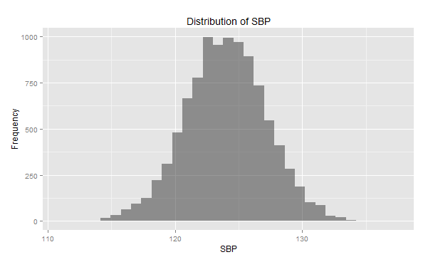
Distribution: Histogram/density plots
library(ggplot2)
qplot(SBP, data=data, geom="density", alpha=I(.5), main="Distribution of SBP", xlab="SBP", ylab="Density")
qplot(SBP, data=data, geom="histogram", alpha=I(.5), main="Distribution of SBP", xlab="SBP", ylab="Frequency")
FORMAL NORMALITY TESTS: moment coefficient of kurtosis/skewness, Shapiro wilk, Kolmogorov sminorff !!!!

Slide 8
Covariate selection:
Aim: parsimonious/simple.
Retain a variable if deemed important.
Methods:
- In case of many variables : - variable importance plots (random forest) or can use variable reduction techniques e.g. PCA.

Slide 9
Variable importance plot
library(randomForest)
rf <- randomForest(SBP ~ ., data=data, ntree=1000,keep.forest=FALSE, importance=TRUE)
varImpPlot(rf,main="Variable importance plot")

Slide 10
Multicollinearity check!!
Screen for multicollinearity.
- correlation matrix (continuous variables)

Slide 11
Scatterplots : Nature of relationships

Slide 12
Systematic/mean component
Y = β₀ +β₁X₁ + β₂X₂ + ... + β_{i}X_{i} + ε
Systematic component
May contain interactions/effect modifiers.
Polynomials/ fractional polynomial.
Or any suitable function that best describes the response surface.

Slide 13
Model selection
Model 1- 15 (word document: models)
R codes: SBP_codes.R
Has all possible combinations for the mean structure.
Best model based on AIC : model5
Other model selection criteria : Cp mallow, adjusted R square, LRT for nested models.

Slide 14
Selected model output
summary(model5)
Call:
lm(formula = SBP ~ Age + salt_sugar)
Coefficients:
Signif. codes: 0 ‘***’ 0.001 ‘**’ 0.01 ‘*’ 0.05 ‘.’ 0.1 ‘ ’ 1
Residual standard error: 1.863 on 9997 degrees of freedom
Multiple R-squared: 0.6516, Adjusted R-squared: 0.6515
 | Estimate | Std error | P value
intercept | 105.900 | 0.205 | <0.0001
Age | 0.655 | 0.009 | <0.0001
Salt_sugar | 0.643 | 0.009 | <0.0001

Slide 15
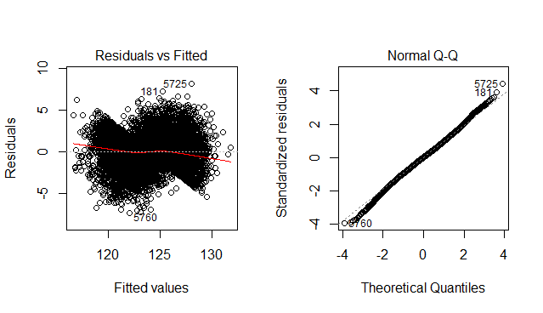
Model diagnostics
Normality and constance of variance
Non-independence of errors (Durbin Watson : D=2.07)

Slide 16
Coefficient interpretations
Age : A difference in age by 1 year for individuals who take similar quantities of salt/sugar implies +0.655 SBP.
Salt_sugar : For individuals of the same age, an additional intake of salt/sugar 1 spoon implies +0.643 SBP.
What is the interpretation of the intercept??

Slide 17
Interaction
Synonym – effect modification
An effect of interaction occurs when a relation between (at least) two variables is modified by (at least one) other variable.

Slide 18
Additive vs. Non-additive
A. Additive (no interaction)
B. Nonadditive (interaction)
Female
Female
Male
Male
SBP
SBP
Age
Age

Slide 19
Interpreting interaction
Interaction
not a single answer (point estimate)
linear combination of betas
Main effects – interpretation changes to conditional

Slide 20
Suppose model8?
 | Estimate | Std error | P-value
Intercept(β₀ ) | 106.100 | 0.467 | <0.0001
Age(β₁ ) | 0.651 | 0.021 | <0.0001
Salt_sugar(β₂) | 0.598 | 0.095 | <0.0001
Age*Salt_sugar(β₃) | 0.002 | 0.002 | 0.6360

Slide 21
Detection?
Likelihood Ratio Test (LRT)
a) SBP = β₀ + β₁Age + β₂salt_sugar
b) SBP = β₀ + β₁Age + β₂ salt_sugar + β₃Age* salt_sugar
Hypothesis: H₀ : β₃ =0 vs. H₀ : β₃ ≠0
library(lmtest)
lrtest(model5,model8)
LogLik Df Chisq Pr(>Chisq)
-20408
-20408 1 0.2245 0.6357
Conclusion : β₃ =0

Slide 22
Interaction in logistic regression
logit(p) = β₀ + β₁*female + β₂*math + β₃*female*math
Response : Being in honors class.
 | Estimate | Std error | P value
Intercept | -8.74 | 2.13 | <0.0001
Female | -2.89 | 3.09 | 0.349
Math | 0.13 | 0.04 | <0.0001
Female*Math | 0.067 | 0.05 | 0.210

Slide 23
Cont:
In the presence of interaction term of female by math, we can no longer talk about the effect of female, holding all other variables at certain value, since it does not make sense to fix math and femalexmath at certain value and still allow female change from 0 to 1!

Slide 24
Cont:
Two equations arise:
a) For males (female=0), the equation is simply
logit(p) = log(p/(1-p))= β₀ + β₂*math.
b) For females, the equation is
logit(p) = log(p/(1-p))= (β₀ + β₁) + (β₂ + β₃ )*math.

Slide 25
Cont:
For male students, a one-unit increase in math score yields a change in log odds of 0.13.
On the other hand, for the female students, a one-unit increase in math score yields a change in log odds of (.13 + .067) = 0.197.
For male students, the odds ratio is exp(.13) = 1.14 for a one-unit increase in math score and the odds ratio for female students is exp(.197) = 1.22 for a one-unit increase in math score.
The ratio of these two odds ratios (female over male) turns out to be the exponentiated coefficient for the interaction term of female by math: 1.22/1.14 = exp(.067) = 1.07.

